Slide 1
Isaac newton (a scientist)
By Izaak

Slide 2
A famous scientist is born…
Born: 25 December 1642 Newton was born prematurely on Christmas morning, in Woolsthorpe, Lincolnshire. He was a tiny baby, given little chance of survival.
The country he was born into was chaotic and turbulent. England was being torn apart by civil war. Plague was an ever-present threat. Many believed the end of the world was imminent. But the hamlet of Woolsthorpe was a quiet community, little touched by either war or plague, which respected Puritan values of sobriety, simple worship and hard work.

Slide 3
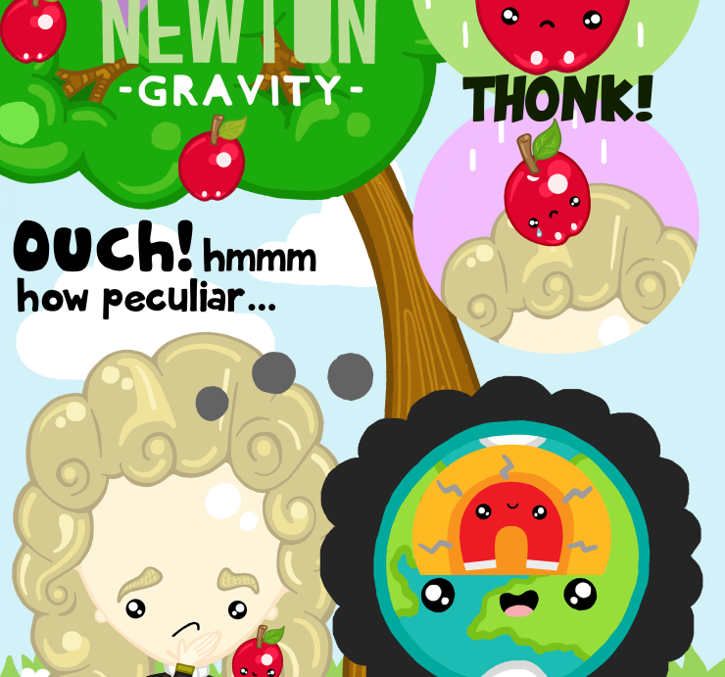
HOW ISAAK LEARNT ABOUT GRAVITY
Isaac found and invented gravity when an apple fell on his head! CLUMSY!!!
Now gravity means nothing but back then it was a big thing.

Slide 4
A PEACEFULL SLEEP
A sad time came when Isaac was in Kensington at the age of 31.(He died)

Slide 5
INFO
Lived 1643 to 1727.
His father, whose name was also Isaac Newton, was a farmer who died before Isaac Junior was born. Although comfortable financially, his father could not read or write.
His mother, Hannah Ayscough, married a churchman when Newton was three years old.
Beginning at age 12, Newton attended The King’s School, Grantham, where he was taught the classics, but no science or mathematics. When he was 17, his mother stopped his schooling so that he could become a farmer. Fortunately for the future of science Newton found he had neither aptitude nor liking for farming; his mother allowed him to return to school, where he finished as top student.
His resentment of his mother and stepfather’s new life did not subside with time; as a teenager he threatened to burn their house down!
Newton disliked his mother’s new husband and did not join their household, living instead with his mother’s mother, Margery Ayscough.

Slide 6
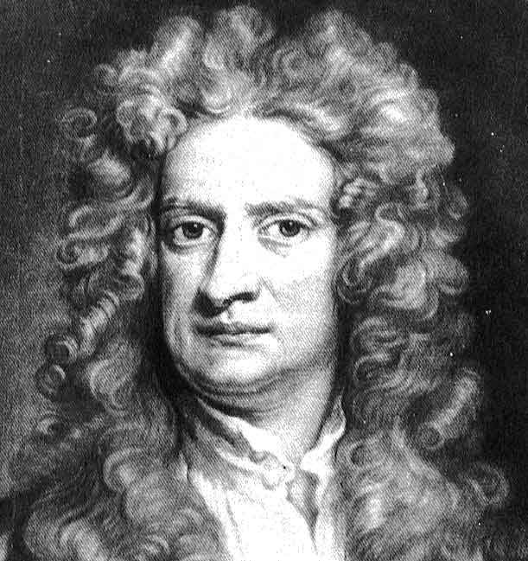
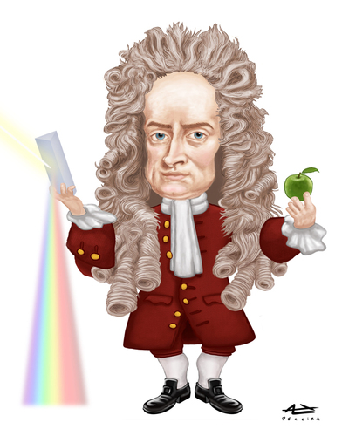
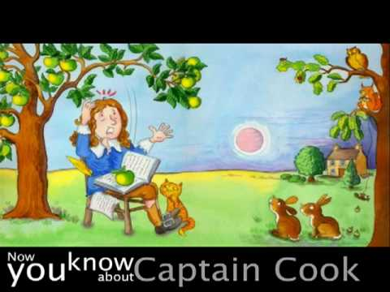
THE PICTURES OF FAME
Because Isaac Newton is famous there are lots of brilliant portraits of this scientist.
As I can`t paint as well as Picasso I found a few paintings!

Slide 7
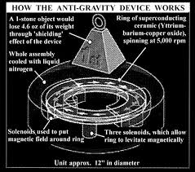
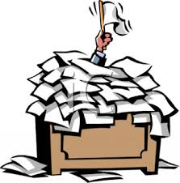
Finding gravity is hard with a lot of work!

Slide 8
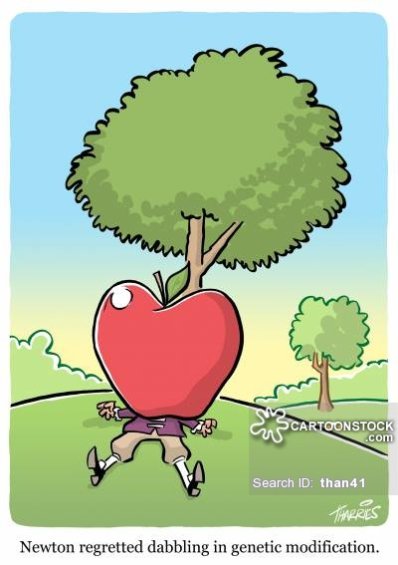
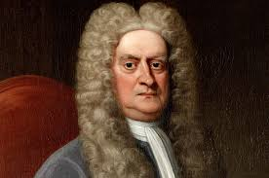
How time passes
At the start
At the end

Slide 9
Thank you for watching

